Slide 1

Department of Computer Science & Engineering Graduate Admissions Presentation

Slide 2
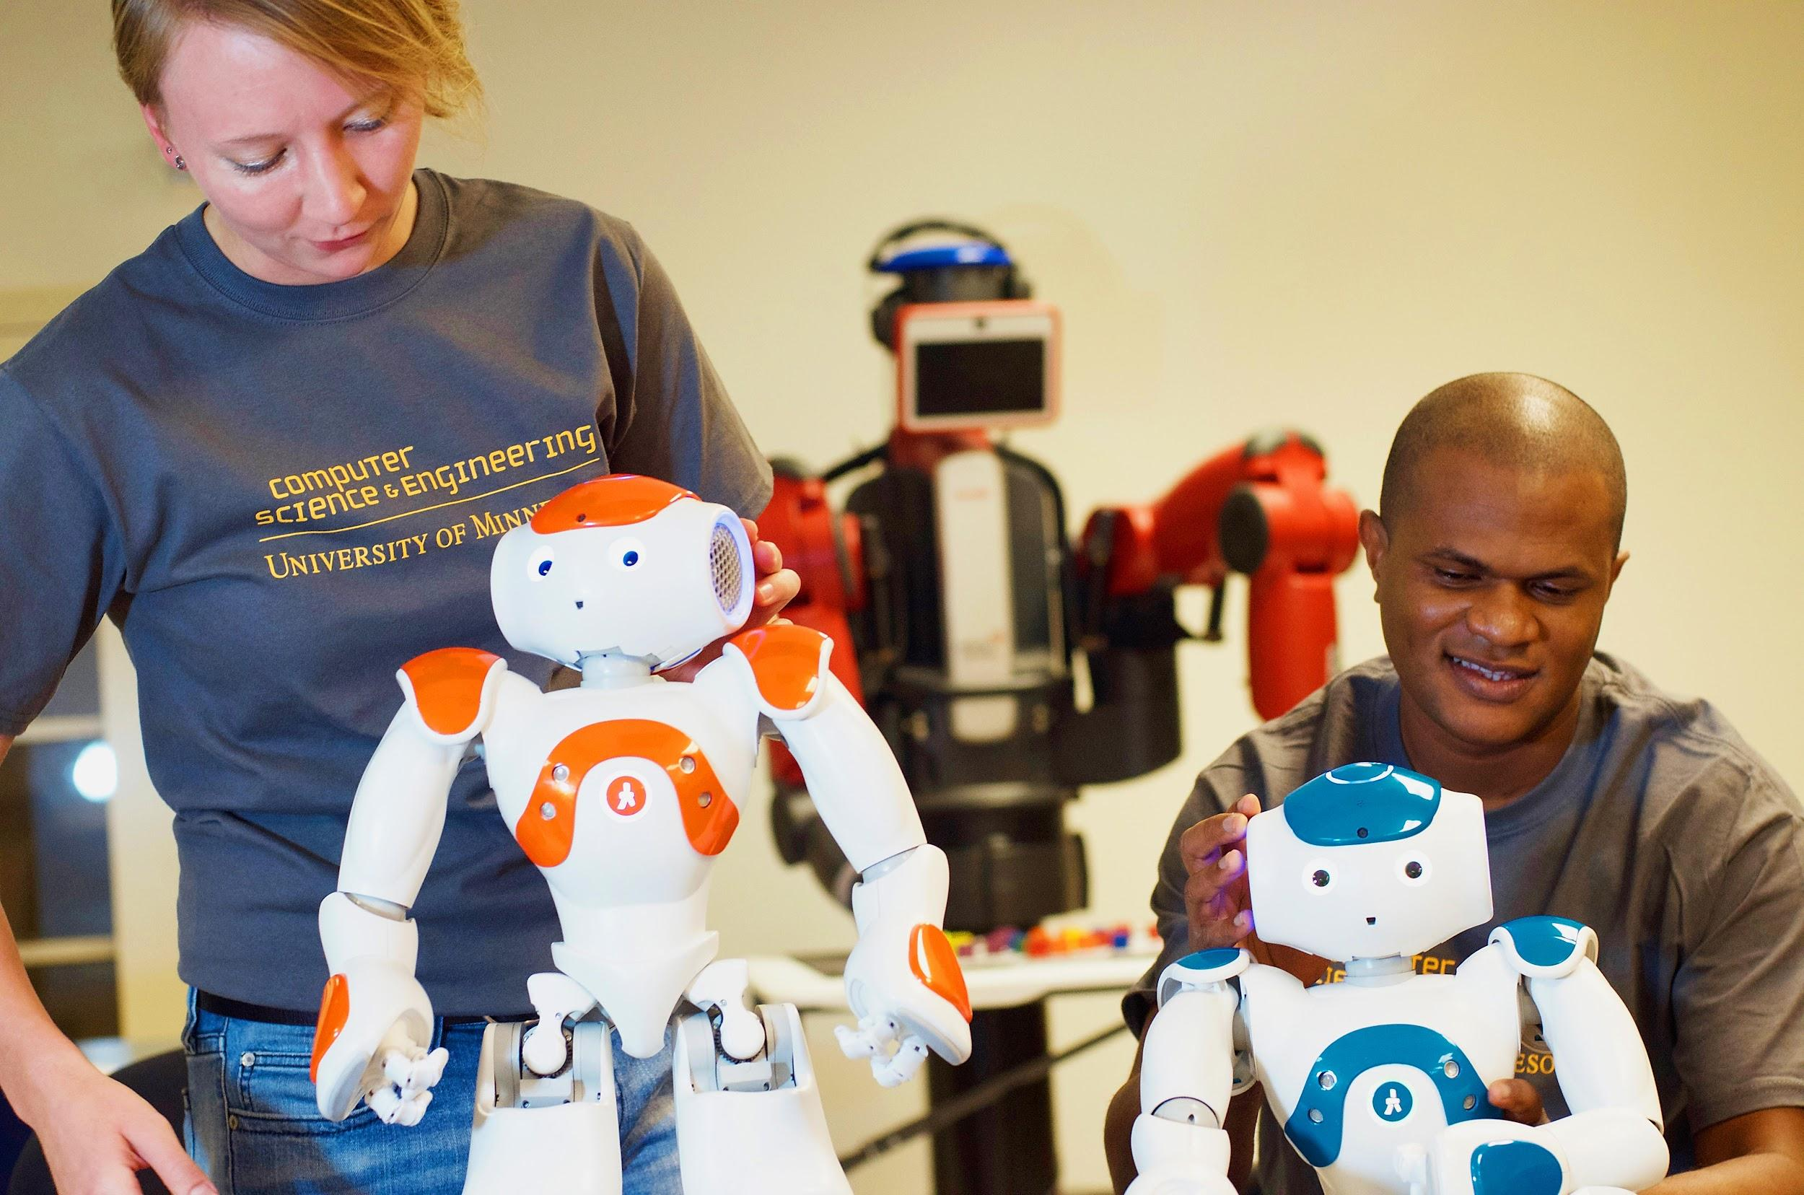
Topics Covered
The Benefits of a Graduate Degree From our Department
Department of Computer Science & Engineering Graduate Program Options
Program Overview and General Program Requirements
Application Information
Pre-requisite requirements
What makes a strong applicant
Funding
Resources

Slide 3
Table of Contents
The Benefits of a Graduate Degree from The Department of Computer Science & Engineering and program options: Slides 4 - 6
Computer Science M.S. program and admissions information: Slides 7-11
Computer Science M.C.S. program and admissions information: Slides 12-15
Computer Science Ph.D. program and admissions information: Slides 16 - 20
Computer Science M.S., M.C.S., Ph.D. Prerequisite Requirements: Slide 21
Data Science M.S. program and admissions information: Slides 22-28
Data Science Certificate program and admissions information: Slides 29 - 33
Data Science M.S. and Certificate Prerequisite Requirements: Slide 34
Masters in Software Engineering (MSSE): Slide 35
Masters in Robotics (MnRI): Slide 36
Bioinformatics and Computational Biology (BICB) program and admissions information: Slides 37 - 38
Graduate school application advice, funding options and additional resources: Slides 39-46
Videos highlighting our department: Slides 47-54

Slide 4
The Benefits of a Graduate Degree from The Department of Computer Science & Engineering
Added credentials may lead to increased career opportunities to include higher level positions, higher salary, and can help lead to a career change.
Increased opportunities for career advancement.
More autonomy in your work.
You can become an expert in the field of computing that interests you.
Most positions in education, K-12 or higher education, will require an advanced degree.
You will have the opportunity to work with world class faculty on state of the art research. Interested students can view some great videos showing Ph.D. student research at conquer.cra.org.

Slide 5
Department of Computer Science & Engineering Core Graduate Programs
Ph.D. in Computer Science. This is a research degree that culminates in a unique dissertation that demonstrates original and creative research. Application instructions can be found here.
M.S. in Computer Science. The department offers three types of M.S. degrees: (i) Plan A with a research thesis, (ii) Plan B with an independent project, and (iii) Plan C that only requires coursework-based projects. Application instructions can be found here.
Masters of Computer Science (M.C.S.) This is a coursework-only degree designed to meet the needs of working professionals. Application instructions can be found here.
Data Science M.S. The Data Science M.S. is a plan B only culminating in a capstone project to include a final written report and oral presentation. Application instructions can be found here.
Data Science Post-Baccalaureate Certificate The Post-Baccalaureate Certificate in Data Science is designed for students seeking expertise in methods of managing and analyzing Big Data in a short four-course program. Application instructions can be found here.

Slide 6
Department of Computer Science & Engineering Associated Programs
Master of Science in Software Engineering (MSSE) This program is designed for working professionals. Students attend classes on alternating Fridays and Saturdays for four semesters. The curriculum builds on the experience of participants. Most homework is team-oriented, and students often learn as much from each other as from the faculty and course materials. Many students find that they learn something each week that can be applied immediately in their professional practice.
Biomedical Informatics and Computational Biology (BICB) The mission of the Bioinformatics and Computational Biology (BICB) graduate program is to provide interdisciplinary education in the area of biomedical informatics and computational biology at the interface of quantitative sciences, medicine, and biology. The graduate program trains graduate students in the development and applications of computational methods and to work in interdisciplinary teams of life scientists and computational scientists.
Robotics MS (MnRI) MnRI takes a multidisciplinary approach to education — take classes from different departments, while engaging in a master's program that gathers the expertise, knowledge and educational assets from across the University of Minnesota, several industries within the state, and beyond.

Slide 7
CS&E Core Graduate Programs -
CSCI M.S. General Degree Requirements
Computer Science M.S. Degree Requirements
The Computer Science M.S. has three plan options, each requires 31 credits to complete the program:
Plan A (21 course credits + 10 research thesis credits)
Plan B (28 course credits + 3 project credits)
Plan C (31 course credits, no research) All Computer Science M.S. students are defaulted to Plan C and can choose to opt in to either research based track if an eligible Computer Science faculty member agrees to serve as your Plan A/B advisor.
Each track has a separate set of requirements though the general structure remains the same.
Fall admission only
Application deadline is March 1st

Slide 8
CS&E Core Graduate Programs -
CSCI M.S. Admissions Information
General Admissions Information for Computer Science M.S.
The following is a list of requirements that are considered as prerequisites for admission to the M.S. program:
A candidate must have demonstrated research potential and interest.
A candidate must have a 4 year or equivalent undergraduate degree from an accredited university
A candidate must have a prior undergraduate or graduate degree in a major with a substantial background in computer science & engineering.
A candidate must have a demonstrated ability to maintain a 3.25 GPA or greater.
We do not require or accept GRE scores as part of the application process.
TOEFL scores should reflect a strong command of the English language and meet the university operational standard.
If a student wishes to apply for a Teaching Assistantship position in the department they must have a score of 23 in speaking and 23 in the writing portions of the TOEFL or equivalent test.
Incomplete applications will not be reviewed for admission.
A personal statement is very important.
Previous degree area is not as important as your prerequisite coursework.

Slide 9
CS&E Core Graduate Programs -
CSCI M.S. Admissions Information
Required and Recommended Application Materials for Computer Science M.S.
Letters of Recommendation: We require three letters of recommendation. You will need to provide the name and contact information for three individuals who can speak to your personal qualities in addition to your academic and research acumen. It is recommended that your letter writers are in higher education, specifically faculty and instructors who have had you in class or worked on research with you. You can also request professional contacts and collaborators who can speak to you work in industry and your ability to conduct high level research if you wish to pursue it. The most important factor in your letters of recommendation is that they speak to you personally and enhance your other application materials.
Personal Statement: A personal statement is very important. Concisely discuss your computer science educational, research, or industrial background as they relate to your objectives. Include any unique experiences relevant to the research you have done. Discuss why you are applying to the University of Minnesota. Please include names of faculty members and research groups at the University of Minnesota whose research is of interest to you. If your goal is to pursue a coursework only degree, you can certainly talk about that as well, it is not required that you decide on plan A/B/C prior to submitting your application. (4000 character limit strongly recommended; does not include spaces not strictly enforced).

Slide 10
CS&E Core Graduate Programs -
CSCI M.S. Admissions Information
Required and Recommended Application Materials for Computer Science M.S.
Diversity Statement: Required of domestic applicants only. International applicants do not need to complete a diversity statement but are welcome to provide one. Be sure to talk about why you as an individual will bring a unique perspective, life experience, background, research interest, professional or academic goal etc to the department. Please feel free to share as much as you are comfortable with the admissions committee.
Research Statement: You may choose to submit a separate research statement detailing your previous research experience and/or what you hope to pursue in our M.S.program. You should reference a particular faculty member, or members, whose own research and area of expertise align with your interests. This is not required for M.S. applicants, but can be included as part of your application package if relevant.
Transcripts: You must indicate all the colleges and graduate schools you have attended. Unofficial transcripts must be uploaded directly to the admissions application per these instructions. Official transcripts are required for those students admitted to the program. Do not fax or mail hard copies of your transcripts, they will be destroyed upon receipt.

Slide 11
CS&E Core Graduate Programs -
CSCI M.S. Admissions Information
Required and Recommended Application Materials for Computer Science M.S.
GRE Test Scores: We do not require or accept GRE scores as part of the application process. The University of Minnesota Graduate Application will have areas for you to enter GRE test scores and upload an unofficial score sheet. You should not enter this information into your application for our program.
TOEFL, MELAB, IELTS Test Scores: International students are required to submit language scores and must send official TOEFL, MELAB or IELTS scores to the Graduate School. For more information visit the Graduate School’s TOEFL information page. Please keep in mind that the department requires a speaking and writing score of 23 or higher to qualify for teaching assistantships. If you are an international student who has been granted a waiver, it is still in your best interests to have a valid language score on file to be eligible for TA appointments.
TOEFL Institution Code: 6874

Slide 12
CS&E Core Graduate Programs -
CSCI M.C.S.General Degree Requirements
Computer Science M.C.S. Degree Requirements
The M.C.S. degree (Master’s of Computer Science) is our coursework-only program for working professionals. Most applicants are interested in expanding their skills but are not interested in pursuing academic research.
The Computer Science M.C.S. is Plan C only (31 course credits, no research).
The admissions requirements for the M.C.S. differs from the Computer Science M.S., the program is aimed at working professionals with 3+ years of experience in a related field.
Work experience in a relevant industry IS required. This should be highlighted on your resume/CV and in your personal statement.
Fall admission only
Application deadline is March 1st

Slide 13
CS&E Core Graduate Programs -
CSCI M.C.S. Admissions Information
General Admissions Information for Computer Science M.C.S.
The following is a list of requirements that are considered as prerequisites for admission to the M.C.S. program:
A candidate must be a professional working in the Computer Science field or a closely related field at the time of application.
A candidate must have a prior undergraduate or graduate degree in a major with a substantial background in computer science & engineering.*
A candidate must have a demonstrated ability to maintain a 3.0 GPA or greater.
TOEFL scores must meet university operational standard.
Incomplete applications will not be reviewed for admission.
*Well-qualified applicants without an undergraduate/graduate computer science major will be considered, applicants with a computer science major will be preferred.

Slide 14
CS&E Core Graduate Programs -
CSCI M.C.S. Admissions Information
Required and Recommended Application Materials for Computer Science M.C.S.
Letters of Recommendation: We require three letters of recommendation. You will need to provide the name and contact information for three individuals who can speak to your personal qualities in addition to your academic. It is recommended that your letter writers are in higher education or have worked with you in industry. Specifically, faculty and instructors who have had you in class or worked on research with you. Former or current professional colleagues and collaborators who can speak to your work in industry are also great options. The most important factor in your letters of recommendation is that they speak to you personally and enhance your other application materials.
Personal Statement: A personal statement is very important. Concisely discuss your computer science educational, research, or industrial background as they relate to your objectives. Include any unique skills or relevant professional experience you have that prepares you for an advanced degree. Discuss your short and long term goals and how this degree program will enhance your ability to achieve them. Discuss why you are applying to the University of Minnesota specifically and what you hope to get out of the program, make it personal. (4000 character limit strongly recommended; does not include spaces not strictly enforced).

Slide 15
CS&E Core Graduate Programs -
CSCI M.C.S. Admissions Information
Required and Recommended Application Materials for Computer Science M.C.S.
Diversity Statement: Required of all applicants. Be sure to talk about why you as an individual will bring a unique perspective, life experience, background, research interest, professional or academic goal etc to the department. Please feel free to share as much as you are comfortable with the admissions committee.
Transcripts: You must indicate all the colleges and graduate schools you have attended. Unofficial transcripts must be uploaded directly to the admissions application per these instructions. Official transcripts are required for those students admitted to the program. Do not fax or mail hard copies of your transcripts, they will be destroyed upon receipt.
Students applying to the Computer Science M.C.S. program are required to be physically present in the United States because of logistical issues related to the online learning options.

Slide 16
CS&E Core Graduate Programs -
CSCI Ph.D. General Degree Requirements
Computer Science Ph.D. Degree Requirements
The Ph.D. in Computer Science is a research degree culminating in a unique dissertation that demonstrates original and creative research. Our Ph.D. program is intended to be completed by students who are physically on campus, and is not an online program.
31 course credits to include a combination of courses from defined Computer Science categories and elective coursework to supplement your academic and research pursuits.
24 thesis credits
Qualifying exams to include the Preliminary Written and Oral Examination
Thesis Proposal Exam
Guaranteed funding for admits
Fall admission only
Application Submission Deadline for fellowship consideration is December 15th
Final Application deadline is January 5th

Slide 17
CS&E Core Graduate Programs -
CSCI Ph.D. Admissions Information
General Admissions Information for Computer Science Ph.D.
The Computer Science Ph.D. program admits students for Fall semester only, applicants are not considered for Spring or Summer admission.
The Computer Science Ph.D. program has two application deadlines.
December 15: Ph.D. application deadline to be considered for Fellowships
January 5: Final Application deadline for the following Fall semester.
All admitted students to the Computer Science Ph.D. program are offered funding, guaranteed for the first year. Most students are funded through the duration of their program if they maintain adequate progress towards degree completion.
Admitted students are typically assigned a faculty research advisor at the time of their admission offer. It is in the applicants best interest to reference one or more faculty they would be interested in working with.

Slide 18
CS&E Core Graduate Programs -
CSCI Ph.D. Admissions Information
Required and Recommended Application Materials for Computer Science Ph.D.
Letters of Recommendation: We require three letters of recommendation. You will need to provide the name and contact information for three individuals who can speak to your personal qualities in addition to your academic and research acumen. It is recommended that your letter writers are in higher education, specifically faculty and instructors who have had you in class or worked on research with you. You can also request professional contacts and collaborators who can speak to you work in industry and your ability to conduct high level research. The most important factor in your letters of recommendation is that they speak to you personally and enhance your other application materials.
Personal Statement: A personal statement is very important. Concisely discuss your computer science educational, research, or industrial background as they relate to your objectives. Include any unique experiences relevant to the research you have done. Discuss why you are applying to the University of Minnesota. Please include names of faculty members and research groups at the University of Minnesota whose research is of interest to you. Use this area to list any extenuating circumstances such as poor grades or test scores. (4000 character limit strongly recommended; does not include spaces not strictly enforced)

Slide 19
CS&E Core Graduate Programs -
CSCI Ph.D. Admissions Information
Required and Recommended Application Materials for Computer Science Ph.D.
Diversity Statement: Required of domestic applicants only. International applicants do not need to complete a diversity statement but are welcome to provide one. Be sure to talk about why you as an individual will bring a unique perspective, life experience, background, research interest, professional or academic goal etc to the department. Please feel free to share as much as you are comfortable with the admissions committee.
Research Statement: You may choose to submit a separate research statement detailing your previous research experience and what yo hpe to pursue in our doctoral program. You should reference a particular faculty member, or members, whose own research and area of expertise align with your interests.
Transcripts: You must indicate all the colleges and graduate schools you have attended. Unofficial transcripts must be uploaded directly to the admissions application per these instructions. Official transcripts are required for those students admitted to the program. Do not fax or mail hard copies of your transcripts, they will be destroyed upon receipt.

Slide 20
CS&E Core Graduate Programs -
CSCI Ph.D. Admissions Information
Required and Recommended Application Materials for Computer Science Ph.D.
GRE Test Scores: We do not require or accept GRE scores as part of the application process. The University of Minnesota Graduate Application will have areas for you to enter GRE test scores and upload an unofficial score sheet. You should not enter this information into your application for our program.
TOEFL, MELAB, IELTS Test Scores: International students are required to submit language scores and must send official TOEFL, MELAB or IELTS scores to the Graduate School. For more information visit the Graduate School’s TOEFL information page. Please keep in mind that the department requires a speaking and writing score of 23 or higher to qualify for teaching assistantships. If you are an international student who has been granted a waiver, it is still in your best interests to have a valid language score on file to be eligible for TA appointments.
TOEFL Institution Code: 6874

Slide 21
CS&E Core Graduate Programs -
Prerequisite Knowledge Required for Computer Science M.S., M.C.S., and Ph.D.
There is a base level of prerequisite knowledge expected for all applicants to a Computer Science graduate degree (M.S., M.C.S., and Ph.D.). The knowledge areas we look for can be filled most directly through regular academic coursework, but can also be satisfied with relevant professional and research experience. Please be sure your application materials show academic, professional or research experience in the following categories:
Machine Architecture and Organization
Theoretical Foundations. Must cover one of the following two bodies of knowledge:
Algorithms and Data Structures
Formal Languages and Automata Theory
Operating Systems
Programming & Software Development

Slide 22
CS&E Core Graduate Programs-
DSCI M.S. General Degree Requirements
Data Science M.S. Degree Requirements
The M.S. in Data Science program provides a strong foundation in the science of Big Data and its analysis by gathering in a single program the knowledge, expertise, and educational assets in data collection and management, data analytics, scalable data-driven pattern discovery, and the fundamental concepts behind these methods.
The Data Science M.S. program requires the completion of 31 academic course credits.
Plan B is the only option, students pursue a capstone project under the guidance of an eligible faculty advisor.
Coursework and research in Computer Science, Statistics, and other areas: Public Health, Electrical Engineering, Industrial Engineering, Bio-Statistics, Math, Business
Students are required to create a research poster and present their work at the annual Data Science Poster Fair.
Fall admission only
Application deadline is March 1st

Slide 23
CS&E Core Graduate Programs-
DSCI M.S. Admissions Information
General Admissions Information for Data Science M.S.
Prerequisite Requirements
Our Data Science program consists of rigorous courses in which the following prerequisites are the minimum needed to succeed. The following slide details the minimum requirements to apply, but applicants are expected to significantly exceed these minimum requirements in at least one area related to mathematics, statistics, or computer science, either through their coursework or work experience.
A lack of one or two prerequisites does not automatically preclude admission, but your Statement of Purpose would need to include your plans to fulfill a missing prerequisite. In any case, a complete application must include a list showing how you have fulfilled each of the following prerequisites (list specific courses or experiences) or your plans to fulfill them before or after arrival. Your admission may be conditional on meeting the prerequisites within a defined time frame.

Slide 24
CS&E Core Graduate Programs-
DSCI M.S. Admissions Information
General Admissions Information for Data Science M.S.
Prerequisite Coursework Requirements
Mathematics:
Calculus (2 semesters) Equivalents to MATH 1271 and MATH 1272 at the University of Minnesota
Multivariable Calculus (1 semester) Equivalent to MATH 2263 at the University of Minnesota
Linear Algebra (1 semester) Equivalent to either MATH 2142, MATH 4242, or CSCI 2033 at the University of Minnesota
Statistics (1 semester) Equivalent to STAT 3021 or a higher level STAT equivalent at the University of Minnesota
Computer Programing (2 semesters) or equivalent experience in a general-purpose programming language (e.g., C, C++, Java, Python), including basic algorithms and data structures equivalent to the first two semesters of beginning computer science courses as part of an undergraduate Computer Science degree. Equivalents to CSCI 1103 (java), CSCI 1113 (C/C++), CSCI 1133 (python), CSCI 1913 or 1933 (CS 2 with algorithms and data structures)
Experience with mathematical software environments such as Matlab, R or the equivalent is a definite plus, but not a total substitute for experience with a general-purpose programming language. A class on advanced data structures is also a plus (Equivalent to CSCI 4041 at the University of Minnesota).
Students can find equivalents at other schools by using transferology.

Slide 25
CS&E Core Graduate Programs-
DSCI M.S. Admissions Information
Required and Recommended Application Materials for Data Science M.S.
Letters of Recommendation: Submit the names of three individuals who can speak to your ability to do graduate-level work in Data Science. They will be, ideally, familiar with the background experience described in your Statement of Purpose. One of the three letters must be recent (in the last two years), and if you have been out of school for less than 5 years, it is encouraged for one of three letters to come from a faculty member.
Statement of Purpose/Personal Statement: You must write a statement of purpose outlining your immediate educational and long-range career objectives in relation to Data Science and why you are applying to the University of Minnesota's Data Science program. Discuss any interests in specific research topics or faculty members' projects. In a separate section within the Statement of Purpose, concisely discuss your relevant educational, research, or industrial backgrounds as they relate to data science or data analytics, and the specific prerequisite areas (Calculus and related math classes, statistics, computer programming & related systems). If you have expertise in computing or another prerequisite field that is not reflected in your transcripts, please include a description. Include any unique experiences relevant to the research you have done, especially any data-driven projects. Give an example of the most complicated computer-driven problem you have solved or program you have implemented. (4000 character limit strongly recommended; does not include spaces not strictly enforced)

Slide 26
CS&E Core Graduate Programs-
DSCI M.S. Admissions Information
Required and Recommended Application Materials for Data Science M.S.
Diversity Statement: Required of domestic applicants only. International applicants do not need to complete a diversity statement but are welcome to provide one. Be sure to talk about why you as an individual will bring a unique perspective, life experience, background, research interest, professional or academic goal etc to the department. Please feel free to share as much as you are comfortable with the admissions committee.
Research Statement: You may choose to submit a separate research statement detailing your previous research experience and what you hope to pursue in our data science. You should reference a particular faculty member, or members, whose own research and area of expertise align with your interests.
Transcripts: You must indicate all the colleges and graduate schools you have attended. Unofficial transcripts must be uploaded directly to the admissions application per these instructions. Official transcripts are required for those students admitted to the program. Do not fax or mail hard copies of your transcripts, they will be destroyed upon receipt.

Slide 27
CS&E Core Graduate Programs-
DSCI M.S. Admissions Information
Required and Recommended Application Materials for Data Science M.S.
Curriculum Vitae/Resume: Please submit a Curriculum Vitae or resume detailing your educational institutions attended, degrees awarded, and your employment history, with dates. Include a table or list showing how you have satisfied each of the admission prerequisites listed at the bottom of this page - list specific courses or other specific experiences, even if listed elsewhere in this application.

Slide 28
CS&E Core Graduate Programs-
DSCI M.S. Admissions Information
Required and Recommended Application Materials for Data Science M.S.
GRE Test Scores: The Graduate Record Exam (general test) is not required but is highly recommended, especially for applicants whose previous degree is from a non-US institution. If you choose to submit a GRE score, the official GRE reporting documents must be submitted to the Graduate School of the University of Minnesota only. Do not send your scores to the Department of Computer Science & Engineering, they will be destroyed upon receipt. If submitted, the quantitative section of the GRE has the most impact in the admissions process.
TOEFL, MELAB, IELTS Test Scores: International students are required to submit language scores and must send official TOEFL, MELAB or IELTS scores to the Graduate School. For more information visit the Graduate School’s TOEFL information page. Please keep in mind that the department requires a speaking and writing score of 23 or higher to qualify for teaching assistantships. If you are an international student who has been granted a waiver, it is still in your best interests to have a valid language score on file to be eligible for TA appointments.
GRE Institution Code: 6874
TOEFL Institution Code: 6874

Slide 29
CS&E Core Graduate Programs-
DSCI Certificate General Degree Requirements
Data Science Post-Baccalaureate Certificate
The post-baccalaureate certificate in Data Science is designed for students seeking expertise in methods of managing and analyzing Big Data in a short four-course program.
To complete the certificate, students must complete four classes in three defined categories
For full-time working professionals physically located in the U.S.
Can be completed with in-person or online courses
Courses used to complete the certificate can also be used to complete the Data Science M.S. if admitted.
Fall and Spring admission
Priority deadlines for applying
Fall admission deadline is March 1st
Spring admission deadline is October 1st

Slide 30
CS&E Core Graduate Programs-
DSCI Certificate Admissions Information
General Admissions Information for Data Science Post- Baccalaureate Certificate.
Successful candidates must hold a baccalaureate degree in Computer Science, Statistics, Engineering, or a closely related STEM field with an undergraduate GPA of at least 3.0 (or the equivalent).
Whatever the undergraduate major, applicants must show they satisfy the prerequisites for admission:
2 semesters of computer science fundamentals as coursework or equivalent experience
4 semesters of math/stat (including linear algebra and/or multivariable calculus)
Non-U.S. students must meet a minimum level of proficiency in English as outlined on the Admissions-Requirements page for the M.S. degree.

Slide 31
CS&E Core Graduate Programs-
DSCI Certificate Admissions Information
Required and Recommended Application Materials for Data Science Certificate
Letters of Recommendation: One letter of recommendation is required for admission to the Certificate, but we recommend at least two letters; one familiar with your current situation and (if within 3 years) one familiar with your academic background. The most important factor in your letters of recommendation is that they speak to you personally and enhance your other application materials.
Personal Statement: A personal statement is very important. Concisely discuss your relevant education, research, or industrial background as they relate to your objectives. Include any unique experiences relevant to the research, academic or work in industry that have prepared you for this program. Discuss why you are applying to the University of Minnesota specifically. (4000 character limit strongly recommended; does not include spaces not strictly enforced)

Slide 32
CS&E Core Graduate Programs-
DSCI Certificate Admissions Information
Required and Recommended Application Materials for Data Science Certificate
Diversity Statement: Required of domestic applicants only. International applicants do not need to complete a diversity statement but are welcome to provide one. Be sure to talk about why you as an individual will bring a unique perspective, life experience, background, research interest, professional or academic goal etc to the department. Please feel free to share as much as you are comfortable with the admissions committee.
Transcripts: You must indicate all the colleges and graduate schools you have attended. Unofficial transcripts must be uploaded directly to the admissions application per these instructions. Official transcripts are required for those students admitted to the program. Do not fax or mail hard copies of your transcripts, they will be destroyed upon receipt.
Curriculum Vitae/Resume: Please submit a Curriculum Vitae or resume detailing your educational institutions attended, degrees awarded, and your employment history, with dates. Include a table or list showing how you have satisfied each of the admission prerequisites listed at the bottom of this page - list specific courses or other specific experiences, even if listed elsewhere in this application.

Slide 33
CS&E Core Graduate Programs-
DSCI Certificate Admissions Information
Required and Recommended Application Materials for Data Science Certificate
GRE Test Scores: The Graduate Record Exam (GRE) is not required.
TOEFL, MELAB, IELTS Test Scores: International students are required to submit language scores and must send official TOEFL, MELAB or IELTS scores to the Graduate School. For more information visit the Graduate School’s TOEFL information page. Please keep in mind that the department requires a speaking and writing score of 23 or higher to qualify for teaching assistantships. If you are an international student who has been granted a waiver, it is still in your best interests to have a valid language score on file to be eligible for TA appointments.
TOEFL Institution Code: 6874

Slide 34
CS&E Core Graduate Programs-
Prerequisite Knowledge Required for Data Science Graduate Programs (M.S. and Certificate)
There is a base level of prerequisite knowledge expected for all applicants to a Data Science graduate program(M.S. or Certificate). The knowledge areas we look for can be filled most directly through regular academic coursework, but can also be satisfied with relevant professional and research experience. Please be sure your application materials show academic, professional or research experience in the following categories:
Two semesters of Calculus
Multivariable Calculus
Linear Algebra
Statistics (at least one semester)
Programming experience (C, C++, Java, Python)
Algorithms and Data Structures
* Experience with mathematical software is a plus

Slide 35
CS&E Affiliated Graduate Programs - Masters in Software Engineering (MSSE)
The Masters in Software Engineering (MSSE) program is designed for working professionals. Students attend classes on alternating Fridays and Saturdays for four semesters. The curriculum builds on the experience of participants. Most homework is team-oriented, and students often learn as much from each other as from the faculty and course materials. Many students find that they learn something each week that can be applied immediately in their professional practice.
Masters in Software Engineering (MSSE) Highlights
For full-time working professionals
The program is constructed on a cohort model, students progress through the requirements on a prescribed schedule with their class.
Courses are scheduled on fridays and saturdays, students attend all day sessions a few times per month.
Can be completed in two years
Interested students should review the program website: www.msse.umn.edu
If you would like more information, please contact the program administrator: msse@umn.edu

Slide 36
CS&E Affiliated Graduate Programs - Masters in Robotics (MnRI)
Why study robotics at the Minnesota Robotics Institute
MnRI takes a multidisciplinary approach to education — take classes from different departments, while engaging in a master's program that gathers the expertise, knowledge and educational assets from across the University of Minnesota, several industries within the state, and beyond.
MnRI prioritizes real-world learning — unlike other graduate programs in robotics, the program offered by MnRI features a capstone project to introduce its participants in the deployment of the algorithms and systems into the real-world.
The MnRI faculty— and the University of Minnesota, in general—are connected to key industries and top companies in the state of Minnesota and beyond. We are currently adding on-campus staff from Honeywell and there are vast research options in the state of Minnesota, which has large local presences from 3M, Amazon, Honeywell, Toro, General Mills, Boston Scientific, Medtronic, Land O'Lakes and much more.
The newly renovated Gemini-Huntley Robotics Research Lab inside Shepherd Laboratories offers state-of-the-art lab spaces, spacious conference rooms, general study spaces, and even a two story drone lab.
Interested students should review the program website
If you would like more information, please contact the program administrator: mnri@umn.edu

Slide 37
CS&E Affiliated Graduate Programs - Bioinformatics and Computational Biology (BICB)
The Bioinformatics and Computational Biology (BICB) program offers interdisciplinary graduate education in the area of biomedical informatics and computational biology at the interface of quantitative sciences, medicine, and biology. The graduate program trains graduate students in the development and applications of computational methods and to work in interdisciplinary teams of life scientists and computational scientists.
The BICB graduate program is an interdisciplinary, all-University graduate program between the University of Minnesota’s Twin Cities and Rochester Campuses. BICB leverages the University of Minnesota’s academic and research capabilities in partnership with Mayo Clinic, Hormel Institute, IBM, National Marrow Donor Program (NMDP), the Brain Sciences Center and other industry leaders. The goal is to advance informatics and computation that provide applications to economic activities via innovation, translational research, and clinical experiences to support a strong life science industry in Minnesota.
The program offers industrial and clinical internships and training in business leadership, technology management, and ethics to prepare students for the workplace. Faculty provide education through formal coursework, research seminars, and one-on-one advising. In addition, the program provides a mentoring program for students and junior faculty that will serve as a model for interdisciplinary graduate education.
Interested students should contact the program administrator for more information: bicb@umn.edu

Slide 38
CS&E Affiliated Graduate Programs - Bioinformatics and Computational Biology (BICB)
Bioinformatics and Computational Biology (BICB) Highlights
The Bioinformatics and Computational Biology program offers a Ph.D. and a Master of Science (M.S. Plan A and Plan B) degree. We also offer a graduate Minor with a full suite of academic offerings and research opportunities in this fast growing field to give you the skills and knowledge needed to lead the way to tomorrow’s tools for the quantitative analysis of biological and clinical data.
Integrated education in the life and computational/mathematical sciences.
Collaborative research opportunities
Professional development
World-class supercomputing resources
Semi-annual research symposia

Slide 39
Minnesota Institute of Astrophysics - Data Science Multi-messenger Astrophysics minor
This new program is a collaboration between the Statistics, Physics, Astrophysics, Data Science, Computer Science & Engineering, and Electrical & Computer Engineering graduate programs at the University of Minnesota.
Multi-messenger astrophysics is an emerging field which is experiencing a substantial increase in the amount of data produced to study astrophysical phenomena. Students who participate in the program will receive
practical training on statistical and data science methods while in the regular Data Science program
hands-on experience with big data applications
training in multi-messenger astrophysics
experience using astrophysical data bases
professional development training
While a background in either physics, statistics, or data science would be helpful, it is not required. More information can be found at their website. Any questions about the program should be directed to them.
U.S. citizens and permanent residents will be eligible to apply for stipends for one year and travel support. Others are welcome to participate and will be eligible for travel support.

Slide 40
Graduate School Preparation
There are several things you can do now to ensure your application is competitive. We encourage all applicants to spend time carefully preparing their materials prior to submission.
Connect with faculty now (read their bio pages)
Current students: try to do research or teach now
Current students: work with your career center to create a grad school plan
Thoughtfully construct a statement of purpose
Think about who can write a strong letter of rec (academia or supervisor from work)

Slide 41
What makes a strong applicant?
The following composite profile is typical for an admitted student, however, these marks should not be considered absolute minimus. While all of our graduate programs are competitive, the admissions committee utilizes a holistic review process that takes into consideration all factors and attributes of each individual candidate.
GPA (3.5 or higher is competitive; 3.0 considered a minimum for most)
Prerequisite coursework (mostly A grades)
Language scores for Int Applicants (99 overall TOEFL/6.5 overall IELTS)
21 or 6.5 writing subscore REQUIRED
19 or 6.5 reading subscore REQUIRED
23 or 6.5 speaking subscore considered a minimum
In addition to language test score,GPA, and performance in prerequisite courses and subject areas we also closely analyze an applicants research interests, statement of purpose and letters of recommendation.
Your application materials should tell your unique story and describe what you have done and what you hope to accomplish as part of our department.

Slide 42
Funding Opportunities - General Information
The department is committed to funding all Ph.D. students during their first few years in the program, provided they are making satisfactory progress towards the completion of their degree. M.S. students are also encouraged to apply for available funding options and will be hired as space allows.
Funding is guaranteed to Ph.D. admits and typically provided in one of three ways:
Fellowships
Research Assistantships (RA)
Teaching Assistantships (TA)
Admitted doctoral students are presented with funding information when they receive an offer of admission.
The department does not fund M.S. students at the time of entry into the program. M.S. students have the opportunity to apply for teaching and research assistantships once the begin their program. We also encourage all graduate students to pursue funding opportunities outside of department channels. Additional funding opportunities outside of the department can be found here:
Fellowships and Grants
CS Page on Funding
New and continuing students will be emailed funding opportunities throughout the year

Slide 43
Funding Opportunities -
Teaching and Research Assistantships
The appointment of teaching (TA) and research (RA) assistantships is one of the main ways Computer Science graduate students receive funding. Most appointments are for 50% of full time basis, some may be at 25% (or, on rare occasions, for other percentages such as 12.5%).
A 50% appointment provides a 100% tuition benefit, a 25% appointment gives a 50% tuition benefit. For more detailed information please refer to the Graduate Assistants Employment page. Graduate assistant salaries vary from year to year.
Fifty-percent (or half-time) TA/RA’s are expected to provide an average of 20 hours per week of service, and twenty-five-percent (or quarter-time) TA/RA’s 10 hours. The workload may not be consistent, especially for TA’s, and may fluctuate week-to-week. This is especially true around around examinations or other large assignments in your given course.

Slide 44
Funding Opportunities -
Teaching Assistantships
The Computer Science and Engineering Graduate Program provides financial support to many of its
Graduate students through teaching assistant appointments. The number of such appointments fluctuates
based on a number of financial considerations and variations in enrollment. New doctoral students are awarded teaching assistantships as part of the admissions process. Continuing student may apply in a later semester to be considered for TA positions. The opening date for application submission will be announced through the grad student mailing list.
A teaching assistant's specific duties are assigned by the instructor. These may include, but are not limited to,
conducting laboratory or recitation sessions, assisting students with laboratory and homework
assignments, grading assignments and examinations, and assisting the instructor with the preparation of
course materials. In addition, depending on a TA's experience with the course materials or the particular
instructor, the TA may be required to attend the lectures and/or do all the assignments.
Teaching assistants must be enrolled in a minimum of six credits each semester with the exception of advanced doctoral candidates (those who have passed the WPE/OPE and completed 24 doctoral thesis credits).

Slide 45
Funding Opportunities -
Research Assistantships
Computer science graduate students are eligible for appointments to the position of research assistant (RA)
through various research grants and contracts held by faculty members. Such appointments are
recommended by the principal investigators and not by the DGS or the Graduate Program Coordinator.
Accordingly, students who are interested in being a research assistant (RA) should contact faculty
members directly and indicate their interest in working with them on their research. This is typically the students faculty advisor, or a close collaborator.
The duties performed by a RA will be largely determined by their faculty supervisor, PI or other lead on the funded project
Research assistants must be enrolled in a minimum of six credits each semester with the exception of advanced doctoral candidates (those who have passed the WPE/OPE and completed 24 doctoral thesis credits).

Slide 46
Funding Opportunities -
Fellowships
College of Science & Engineering Fellowships are available to new students and are awarded as part of the admissions process. The Graduate School also offers a variety of fellowships, for more information visit the Graduate School website.
The department maintains this website with funding opportunities available to our graduate students. When appropriate, the department will collect nominations for specific fellowships offered by external organizations. These opportunities and announcements are communicated via email to your University of Minnesota account.

Slide 47
Resources
The Department of Computer Science & Engineering Website will provide you with the following resources and information.
Department Handbook
Additional Program Specific Admissions Information
Faculty Bios
Faculty Research Areas
Department Activities & Organizations
External Fellowship information
Visit the Data Science website for more information on courses, curriculum, and faculty member research areas.
Please also reference the following offices for additional support as needed.
The Graduate School Admissions Office
International Student and Scholar Services (ISSS)
Graduate Student Services and Progress (GSSP)
The College of Science & Engineering Career Center
Parking & Transportation Services (PTS)
Housing and Residential Life
Recreation and Wellness (RecWell)
Golden Gopher Athletics

Slide 48
YouTube Videos
Highlighting research within the Department of Computer Science & Engineering

Slide 49
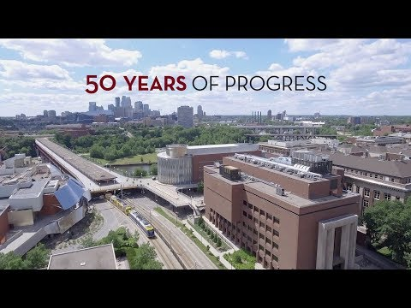
50 Years of Progress: Computer Science & Engineering at the University of Minnesota
Computer Science and Engineering (CS&E) at the University of Minnesota has come a long way in the past 50 years. The department has made tremendous progress and has become one of the most vibrant and interdisciplinary departments in the college, the University, and the computer science field.

Slide 50
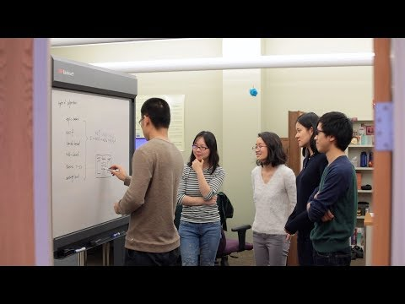
Confronting real-world problems with the Grouplens lab
Grouplens Research Fellows Estelle Smith and Bowen Yu describe how they are developing real-world systems that solve real-world people will use. More info

Slide 51
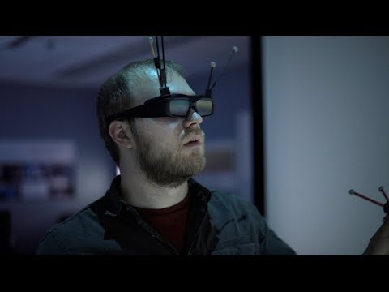
Bringing design and art to science with the IV/Lab
Ph.D. student Seth Johnson is using VR to help scientists visualize and understand the next generation of data.
More info

Slide 52
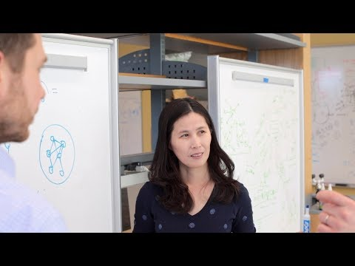
Determining disease risk in the Myers Lab
Research Specialist Wen Wang brings a computational approach to find genetic risks for complex human diseases.
More info

Slide 53
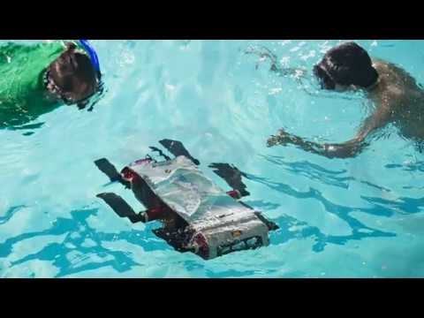
UMN Underwater Robots
Junaed Sattar, founding director of the University of Minnesota’s Interactive Robotics and Vision Lab, shares how his team is contributing to underwater robotics research and efforts to safeguard our environment
More info

Slide 54
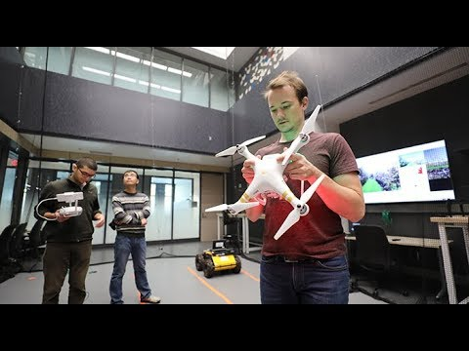
New Robotics Lab at the University of Minnesota
Robotics research at the University of Minnesota received a big boost with the completion of a new Robotics Lab in renovated space on the first two floors of the Shepherd Labs building. The renovation also provides new space for the Solar Vehicle Project. The renovation was funded primarily by about $11 million private support in addition to about $2 million in state funding for the University's MnDRIVE initiative.

Slide 55
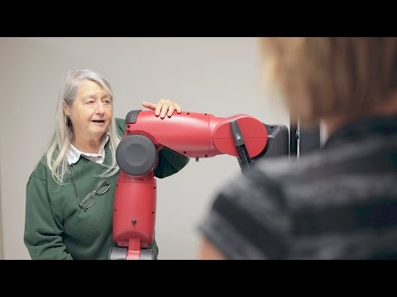
Research Spotlight: Maria Gini
Maria Gini, a professor in the University of Minnesota's Department of Computer Science and Engineering, explains her research on artificial intelligence, which gives computers the ability to make decisions. Her goals are to use artificial intelligence to improve lives for people and to diagnose early symptoms of autism in young children. More info

Slide 56
Go Gophers!

